Slide 1
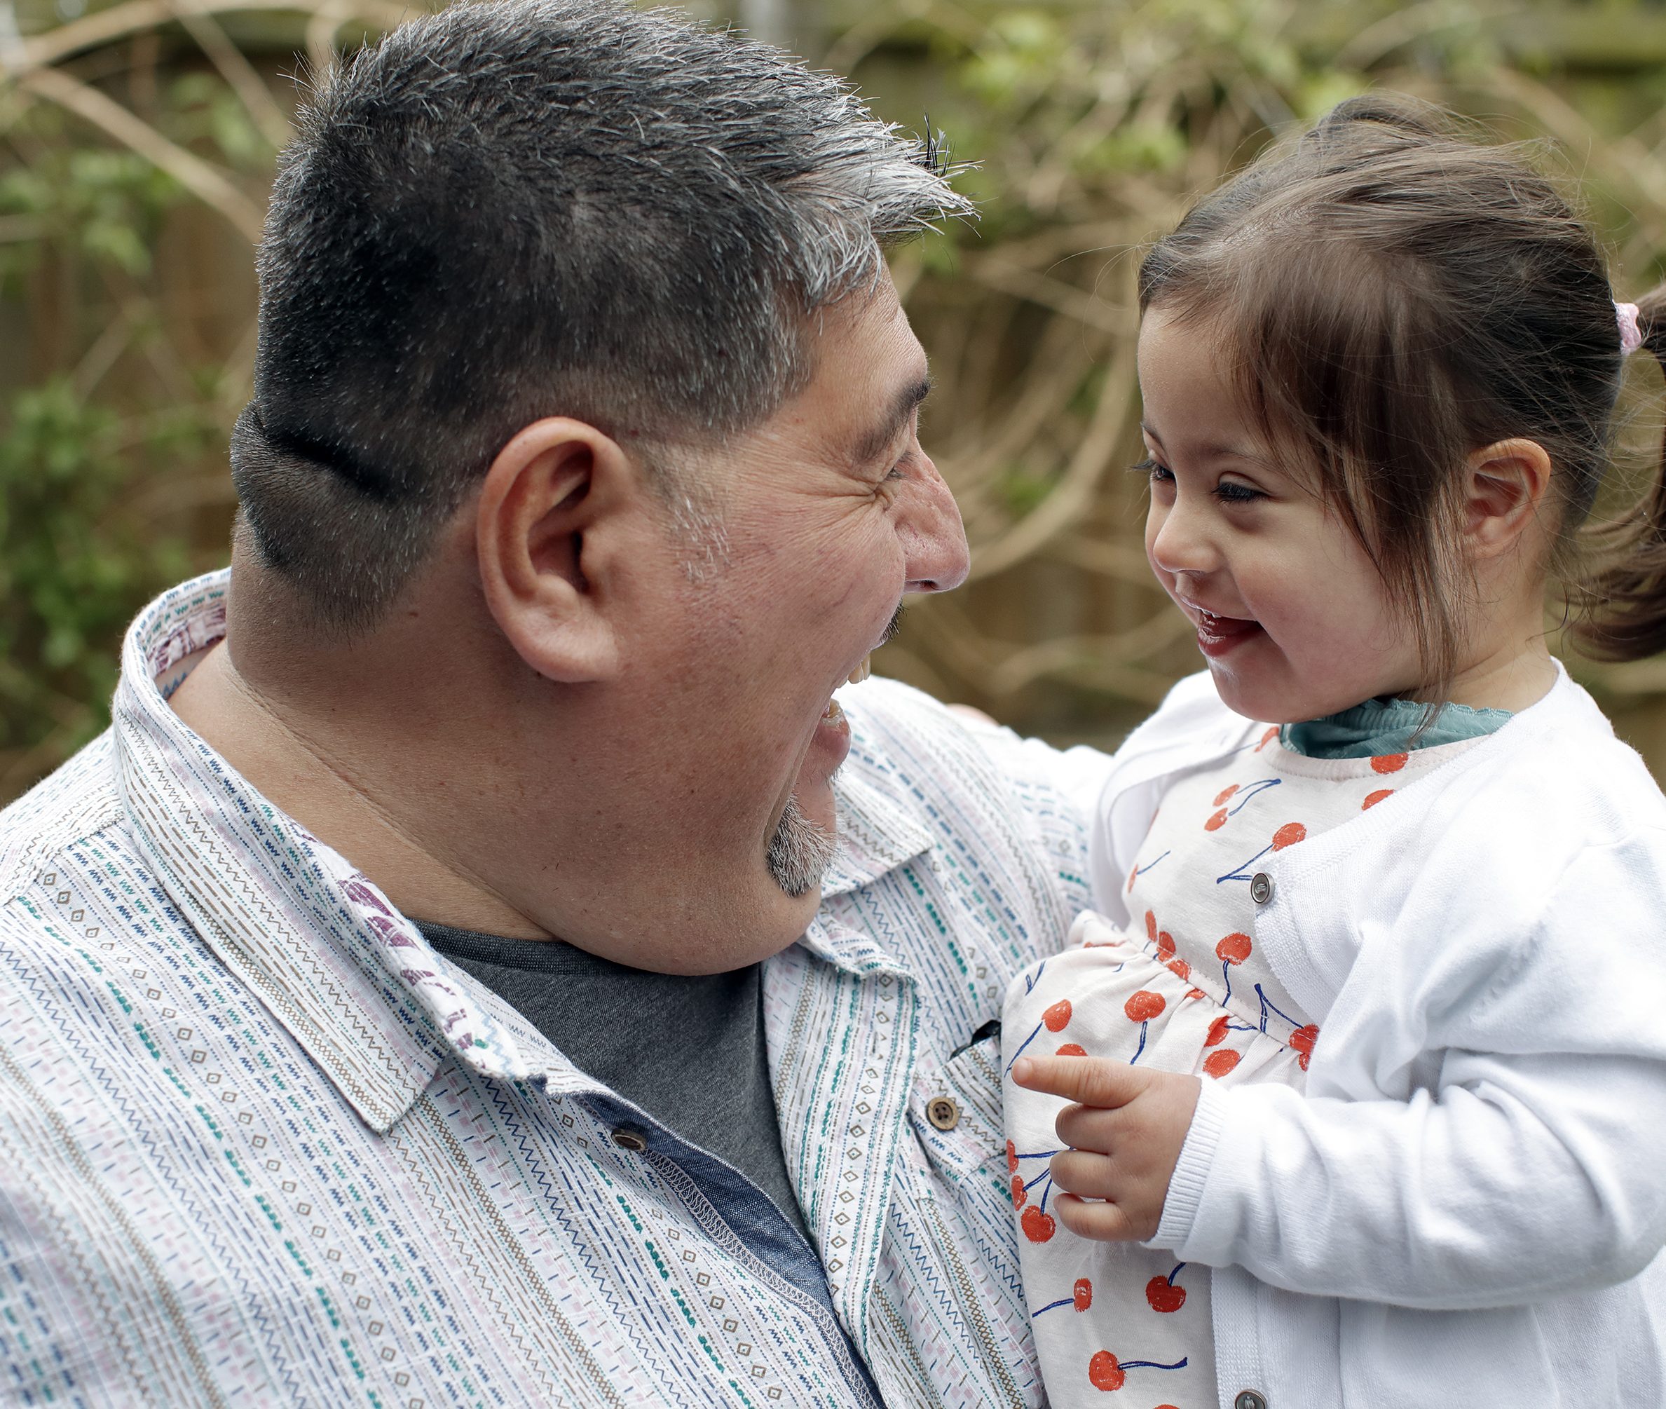
Our Organization
We offer confidential, non-directive, and trained emotional support for new and expectant parents at no charge.
We distribute free accurate, balanced, and up-to-date educational resources about Down syndrome.
We provide information about local resources—such as early intervention—to address social determinants of health.
We do not provide medical advice.

Slide 2

Delivering the News to Expectant Parents
Skotko, B. G., Kishnani, P. S., Capone, G. T., & Down Syndrome Diagnosis Study Group. (2009). Prenatal diagnosis of Down syndrome: How best to deliver the news. American journal of medical genetics Part A, 149(11), 2361-2367.
Carroll, C., Carroll, C., Goloff, N., & Pitt, M. B. (2018). When bad news isn’t necessarily bad: recognizing provider bias when sharing unexpected news. Pediatrics, 142(1), e20180503.
Meredith, S., Brackett, S., Diaz, K. M., Freeman, K. G., Huggins, E., Khan, H., ... & Ayers, K. (2023). Recommendations to improve the patient experience and avoid bias when prenatal screening/testing. Disability and health journal, 16(2), 101401.
Meredith, S., Weiss, S., Kleinert, H. L., & Tyrrell, C. A. (2024). The impact of implicit and explicit bias about disabilities on parent experiences and information provided during prenatal screening and testing. Disability and Health Journal, 17(1), 101514.

Slide 3
Parents want to know what kinds of genetic screening and diagnostic tests are used, what risks are involved with each screen/test, and that prenatal screening gives a numerical score (not a “positive” or “negative” result).

Slide 4
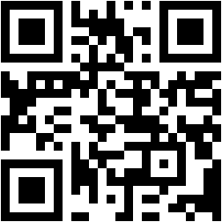
Parents want to understand different reasons for testing: advance awareness, pregnancy management, adoption, reassurance.
The National Down Syndrome Adoption Network maintains a registry of families interested in adopting babies with Down syndrome.
www.ndsan.org

Slide 5
Parents want their physician to present the diagnosis, and find it most helpful when specialists work together.

Slide 6
Parents value physicians sharing the news with both parents present, in a private setting or during a pre-scheduled phone conversation.

Slide 7
Parents want physicians to discuss the diagnosis with neutral language and sensitivity.
“I have bad news”
“I’m sorry”
“I have what may be unexpected results”

Slide 8
Parents want “up-to-date information about Down syndrome, its causes, and expectations for a child living with Down syndrome today.”

Slide 9
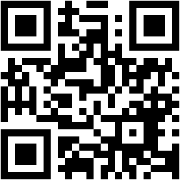
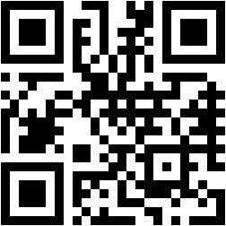
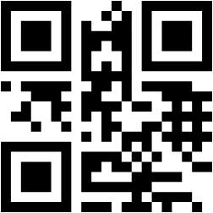
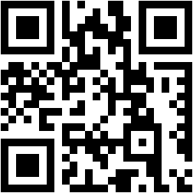
National Center for Prenatal & Postnatal Resources
www.lettercase.org
Down Syndrome Diagnosis Network
www.dsdiagnosisnetwork.org
National Down Syndrome Society
www.ndss.org
National Down Syndrome Congress
www.ndsccenter.org
State department of public health (Down Syndrome Information Acts)

Slide 10
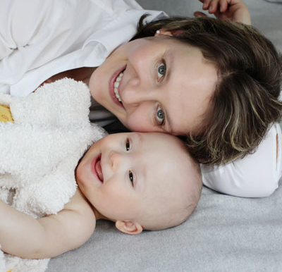
Parents often want access to other families who have children with Down syndrome.

Slide 11
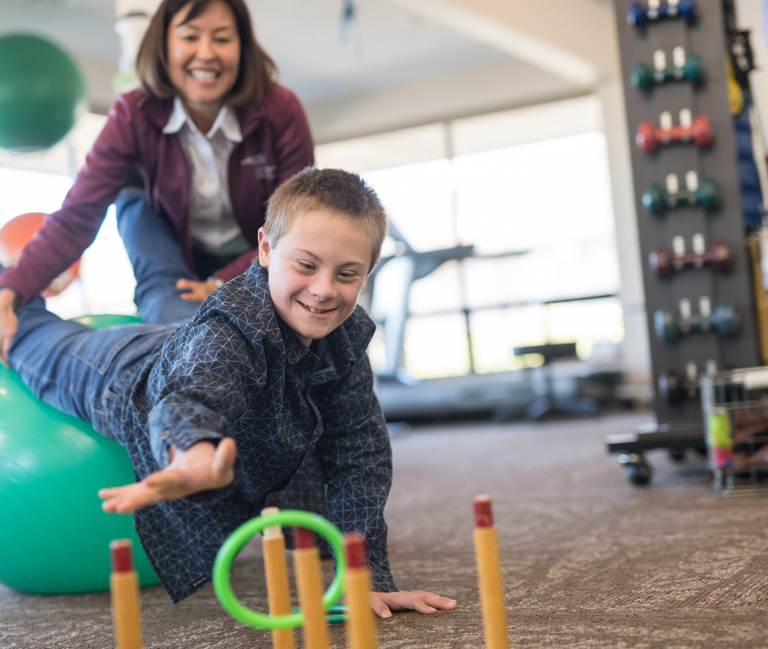
Local Organizations
Free educational resources for hospitals and physician groups
Confidential, non-directive, trained support for new and expectant parents at no charge
  HIPAA medical release forms
  Support services in Spanish and other select languages
Connections to support community
[Add whatever else your organization offers for medical providers or new and expectant parents, like new parent breakfasts or baskets.]

Slide 12

Down Syndrome Today

Slide 13

Improved Healthcare
AVSD heart surgery success nearly 100% (Cincinnati Children’s Hospital)
Life expectancy about 60
(Glasson et al., 2002)
AAP Health Supervision for Children and Adolescents With Down Syndrome
(Bull et al., 2022)
Down Syndrome specialty clinics (https://www.globaldownsyndrome.org/research-medical-care/medical-care-providers/)

Slide 14

Benefits to Families and Siblings
Parent benefits
97% of brothers/sisters, ages 9-11, said they love their sibling (Skotko, 2011)
Siblings more compassionate, well-adjusted (Dykens, 2005)

Slide 15

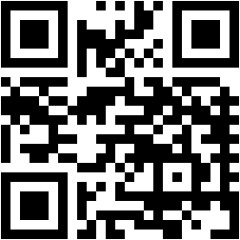
Early Intervention
Free or sliding scale support, therapy, and services from birth to 3
Center for Parent Information and Resources
www.parentcenterhub.org

Slide 16

Inclusion in Schools
Special education services available:
therapy,
small group,
modifications, etc.
Inclusion more common

Slide 17

Community Inclusion
Included in many activities such as dance, sports, arts, clubs, Special Olympics, etc.

Slide 18

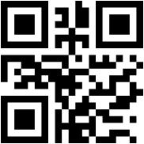
Post-Secondary Education and Employment
More than 300 college programs for people with intellectual disabilities
thinkcollege.net
Working as teaching assistants, artists, actors, etc.

Slide 19
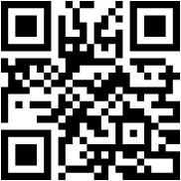
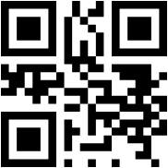
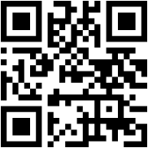
Additional Resources for Medical Professionals
Lettercase
Delivering a Diagnosis: summary of best practices for delivering a diagnosis
Free online training modules with CEU and CME credit for medical professionals
Free online and print resources, reviewed by representatives of the national medical and advocacy organizations, for clinicians to give expectant parents first learning about a diagnosis (available in 15 languages)
Down Syndrome Pregnancy
Free resources for expectant parents preparing for the birth of the baby with more detailed information
downsyndromepregnancy.org
lettercase.org
Jack’s Basket
Free “Communicating Unexpected News” curriculum with CME credit
jacksbasket.org/curriculum

Slide 20
The photography in this presentation is copyrighted. The copyright is owned by the photographer, Conny Wenk. She has granted us a free license to use her photos for the limited purpose of using them for advertising materials on the DownSyndromePregnancy.org website.
You may use this presentation as a free resource and customize the content about your organization and what you offer.
You may provide a link to downsyndromepregnancy.org on your website, but you are NOT allowed to store the presentation on your website. You are not permitted to reproduce any of the images from the presentation for any reason, except when presenting a full copy of the entire presentation as detailed above.
Any special requests for uses of the materials outside the scope of this notice should be directed to info@downsyndromepregnancy.org.

