Slide 1


Down Syndrome
And Your Practice

Slide 2
Today’s Agenda
Down Syndrome Basics
Our Organization
Best Practices
Resources

Slide 3
Down Syndrome Basics

Slide 4
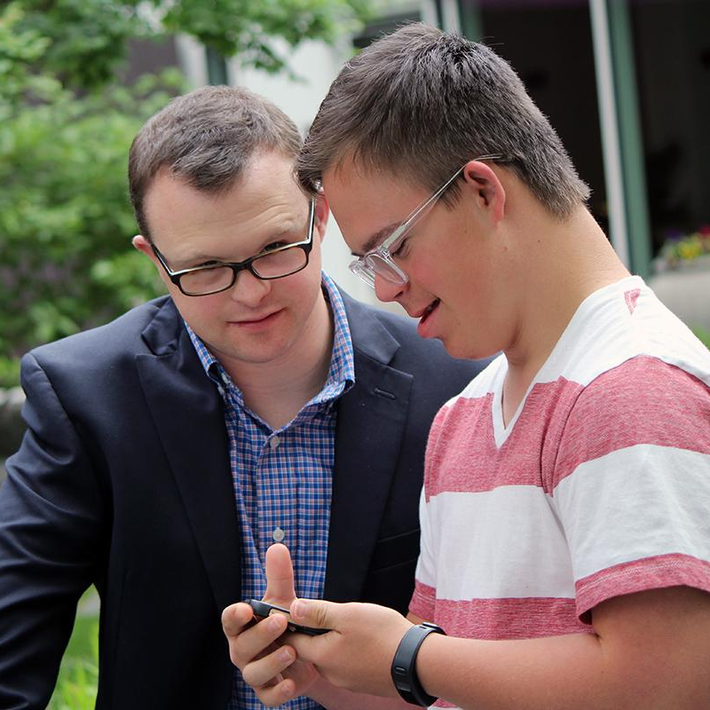

What Is Down Syndrome?
Down syndrome (DS) is caused by extra material of chromosome 21:
Trisomy 21 (most common): Three full copies of chromosome 21
Translocation: Partial or full copy of chromosome 21 attached to another chromosome
Mosaicism: Some cells have three copies of chromosome 21 and some have two copies
DS is associated with some level of intellectual disability and an increased likelihood of certain health conditions, such as heart defects.
People with Down syndrome attend school, work, build meaningful relationships, participate in decisions that affect them, vote, and contribute to their communities in many ways.
The average life expectancy for people with DS is about 60.

Slide 5
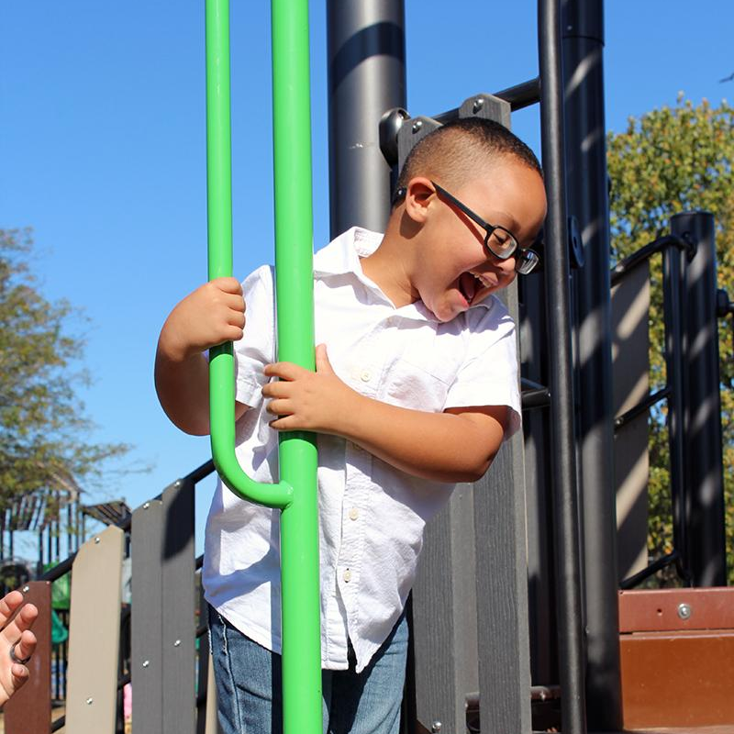
Who Does DS Affect?
Babies with Down syndrome can be born to parents of any age.
While older parents have a higher individual likelihood, younger parents have more babies overall and therefore account for a larger number of births of babies with DS.
DS occurs equally in people of all ethnic, racial, religious, and socioeconomic groups.
In [your local region] [#] babies are expected to be born with DS each year.

Slide 6
Our Organization

Slide 7

[Organization]
We support people with Down syndrome and their loved ones from [life stages served - birth, childhood, adolescence, adulthood, lifespan] across [geographic area].
Our staff include [types of staff - therapists, social workers, family volunteers].

Slide 8



Programs & Services
Program/Service
Program/Service
Program/Service
Description
Cost: FREE [or $ amount]
Description
Cost: FREE [or $ amount]
Description
Cost: FREE [or $ amount]
Notes:
Examples of program services: parent-to-parent, caregiver education

Slide 9
Referral Process
Organization
123 St Name
City, State Zip
(123) 456-789
email@example.com
[step 1]
[step 2]
[step 3]
[step 4]
[step 5]

Slide 10



Upcoming Event
Get involved in our organization and the Down syndrome community by joining [event name]!
[date/time]
[location]
Learn more at www.[website].org!

Slide 11
Best Practices

Slide 12
Quick Tips
For a More Inclusive Practice
Avoid framing Down syndrome as “negative” or “bad news,” especially when discussing a new diagnosis.
Share social perspectives and social support resources.
Encourage office staff to proactively ask caregivers, “Is there anything we can do to accommodate your loved one?” prior to appointments.
Speak directly to people with Down syndrome, not only to caregivers.
Use visuals aids and show diverse photos of people with DS.
As children grow into adolescence and adulthood, actively involve them in their healthcare decisions.

Slide 13
Resources

Slide 14




National Organizations
National Down Syndrome Congress
National Down Syndrome Society
Provides advocacy, information, education, and support to people with DS and families with an annual conference.
Provides advocacy and information for people with DS and families across the lifespan.
Down Syndrome Diagnosis Network
Parent to Parent USA
Provides online support to parents of young children with Down syndrome with an annual retreat.
Provides support to parents of children with disabilities.
Notes:
Also include any local Down syndrome clinics

Slide 15
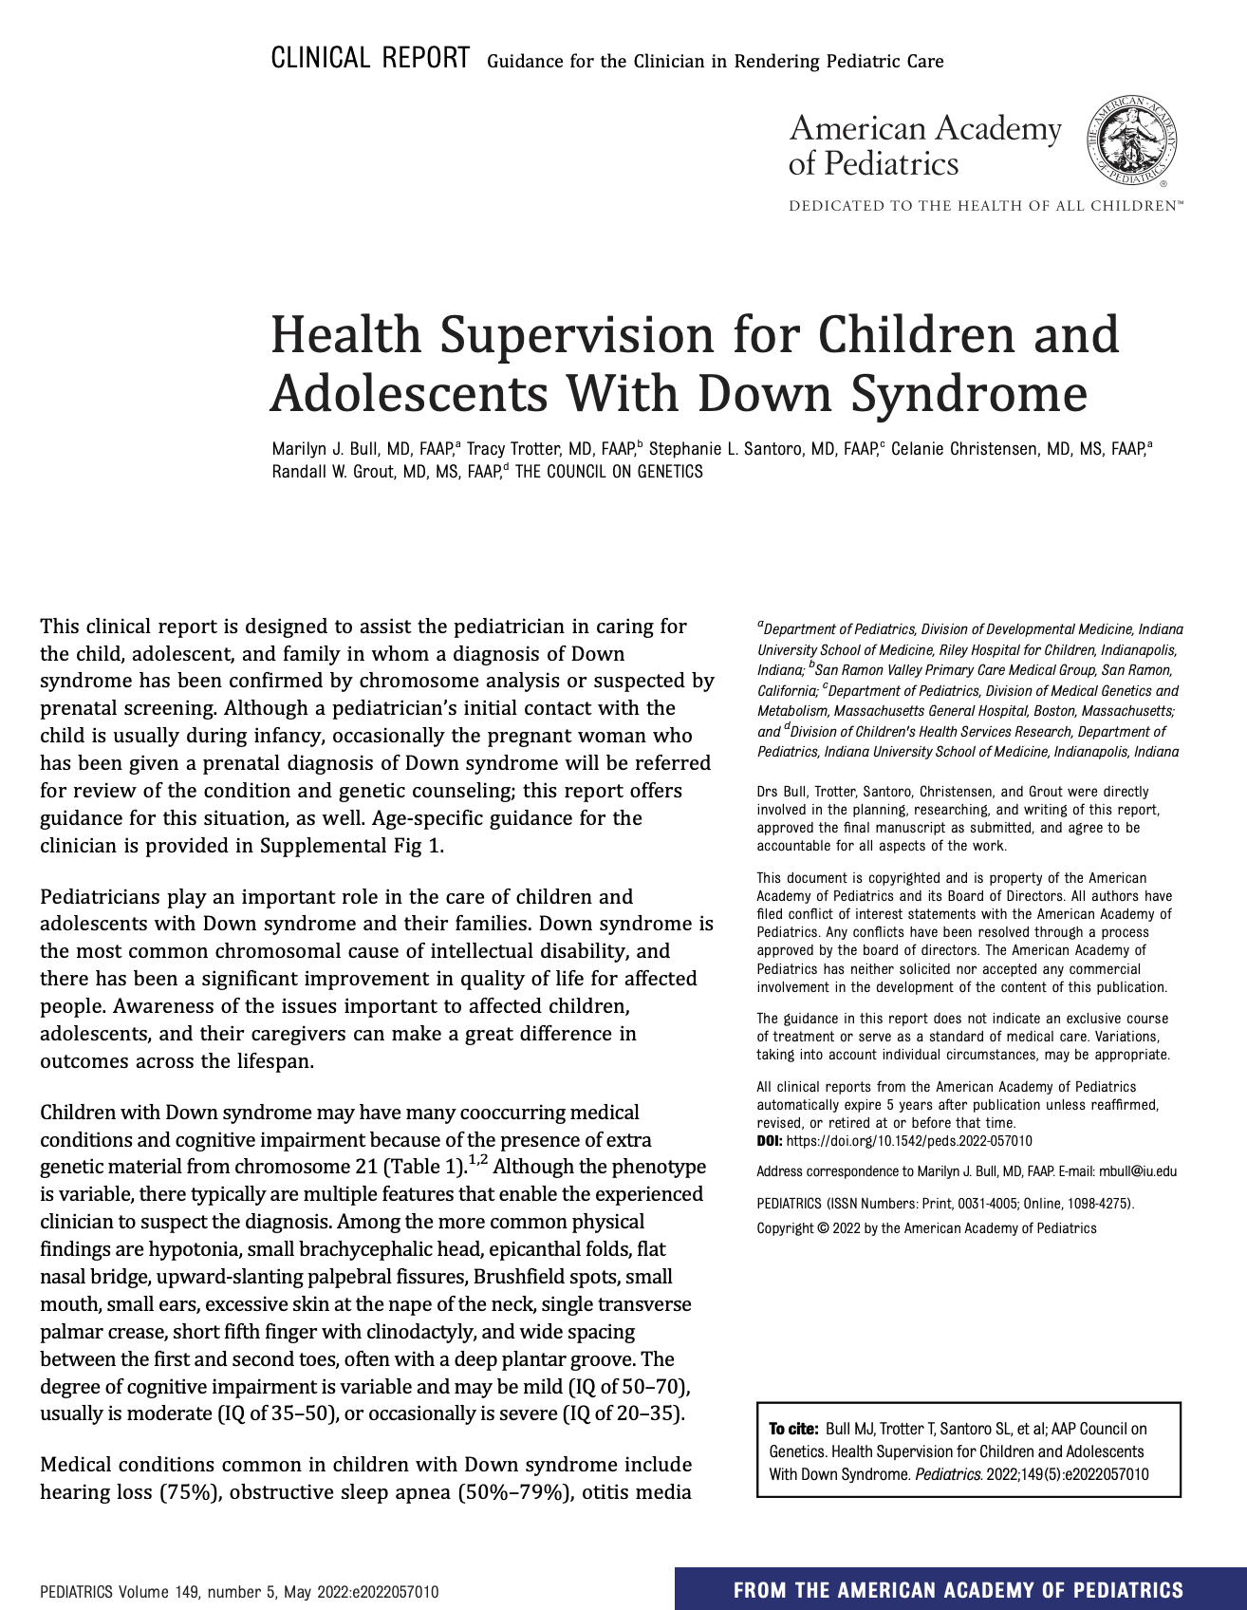



Pediatric Resources
AAP Guidelines
Lettercase/Down Syndrome Pregnancy
Health Supervision for Children and Adolescents With Down Syndrome
Prenatal and Postnatal Resources
Basket Programs
National Parents First Call Center
MDSC call center for expectant parents and medical professionals
Jack’s Baskets Rising Kites
Notes:
Also include any local Down syndrome clinics

Slide 16
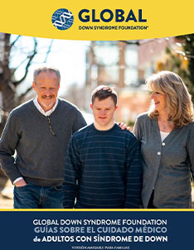
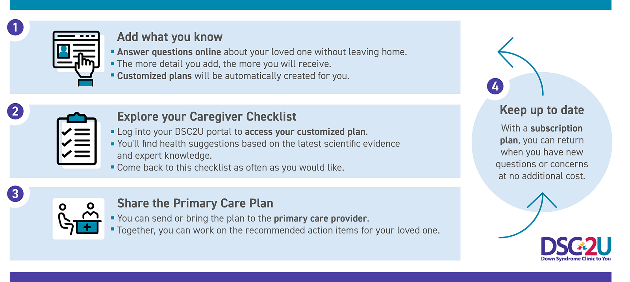
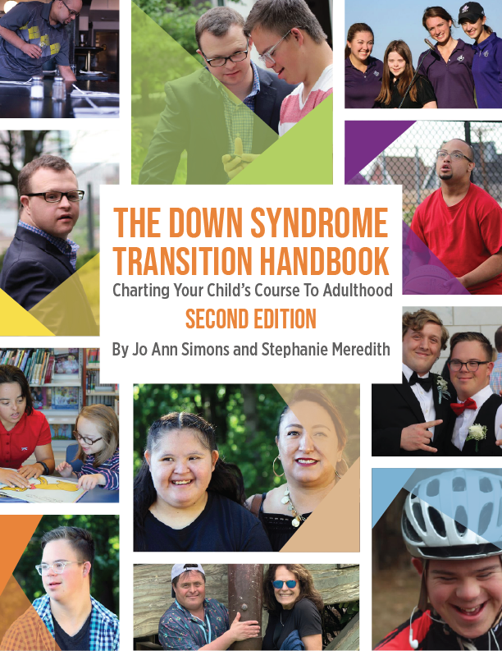
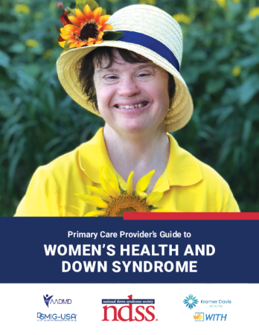
Down Syndrome Resources
GLOBAL Down Syndrome Foundation Guidelines
Individualized Care Plan
Down Syndrome Clinic 2 (DSC2U)
Medical Care Guidelines for Adults with Down Syndrome
Down Syndrome Transition Handbook
NDSS Women’s Health Guide
Guide to transitioning from childhood to adulthood.
Comprehensive health guide for women with Down syndrome
Notes:
Also include any local Down syndrome clinics

Slide 17
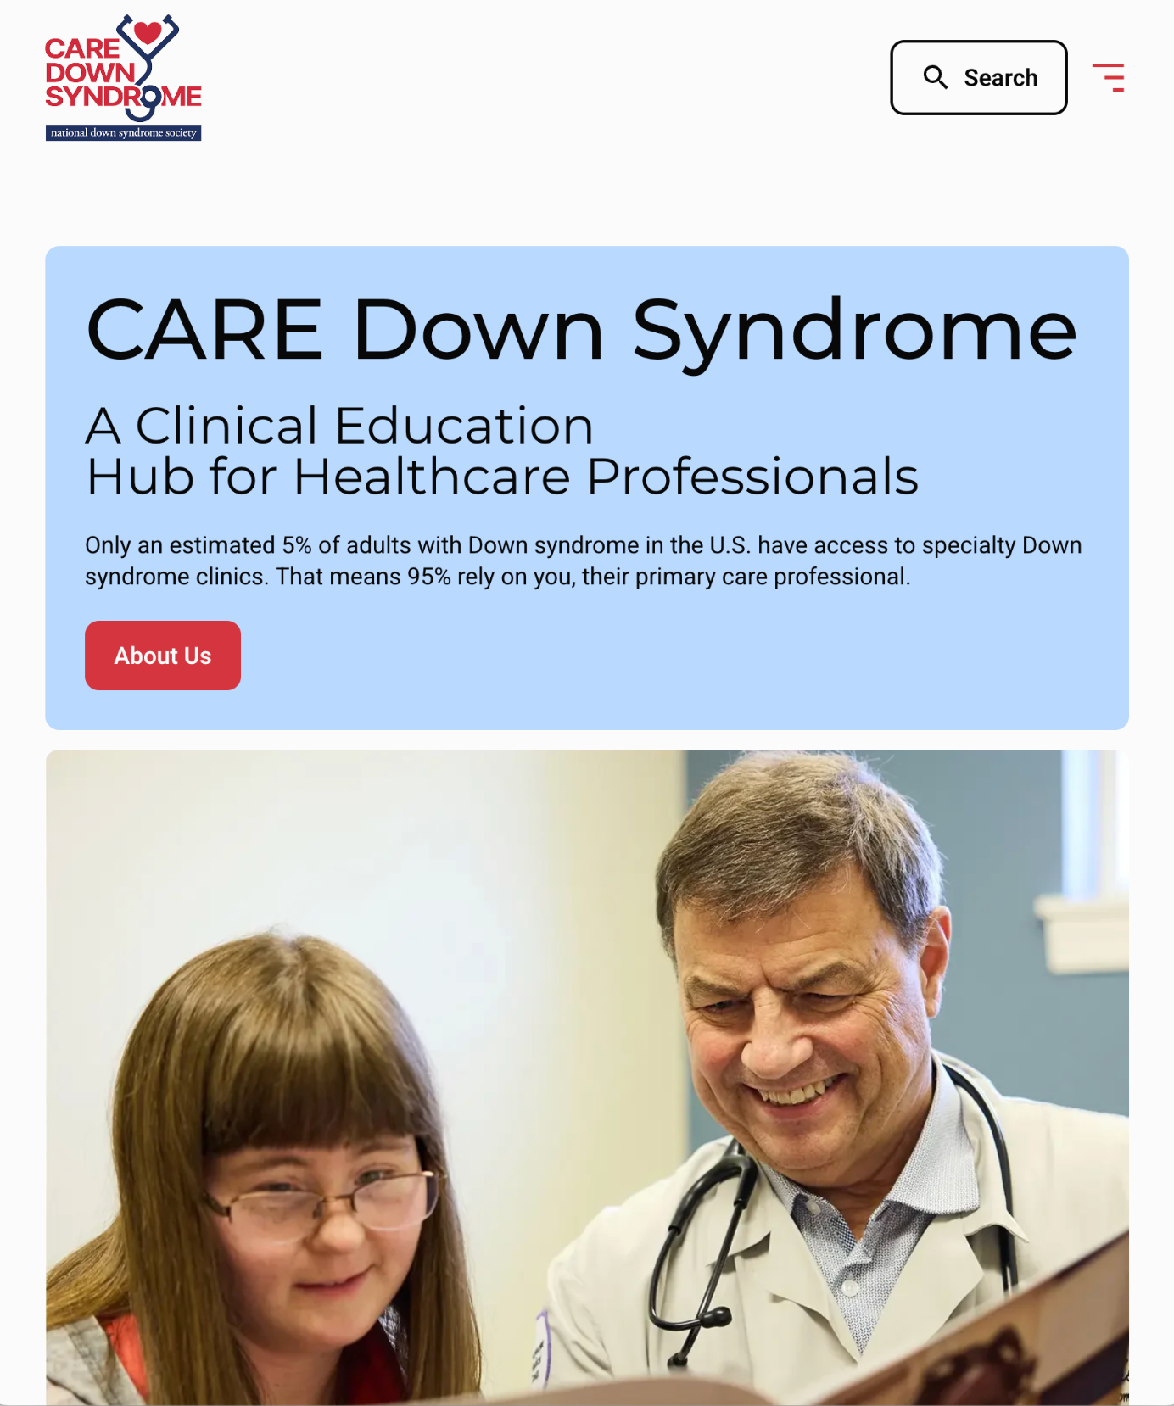
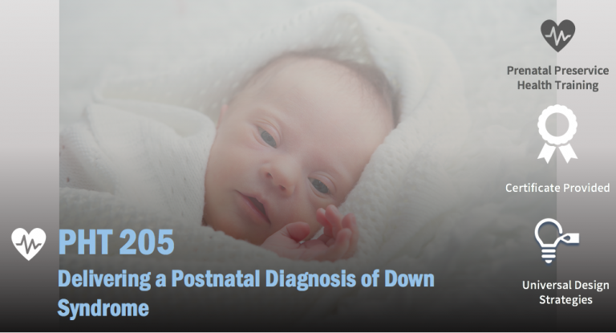
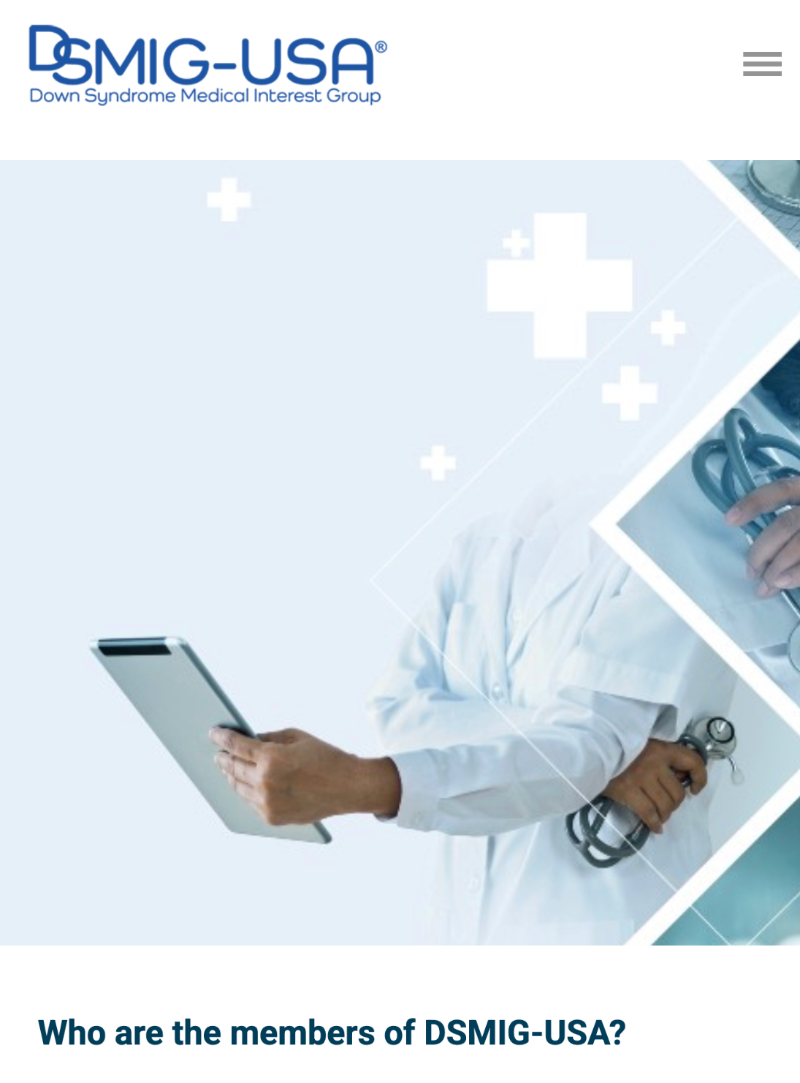
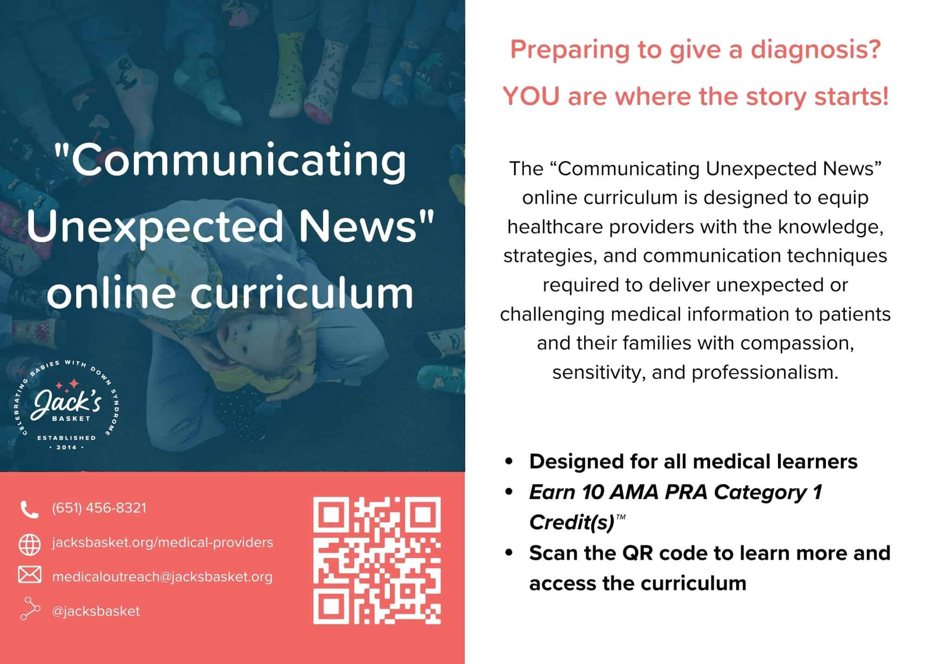
Physician Resources
NDSS Care Down Syndrome
Lettercase
A Clinical Education Hub for Healthcare Professionals
“Brighter Tomorrows” courses
Medical Interest Group
Jack’s Basket
Down Syndrome Medical Interest Group (DSMIG)
“Communicating Unexpected News” curriculum
Notes:
Also include any local Down syndrome clinics

Slide 18
Any Questions?

